Slide 1

Tuesday 20th September 2022

Slide 2
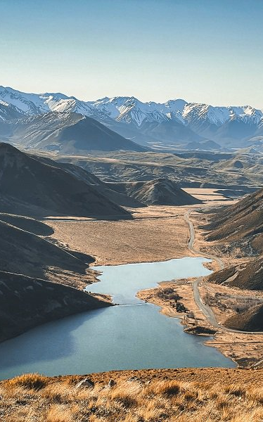


Selwyn Business Survey – August 2022
Benje Patterson
Independent economist
benje@benjepatterson.co.nz
20 September 2022

Slide 3
Fifth biannual survey
This is the 5th survey we have run
Survey helps us understand local conditions that gets lost in national data
Not just experiences to date, but what businesses expect for themselves in the months ahead

Slide 4
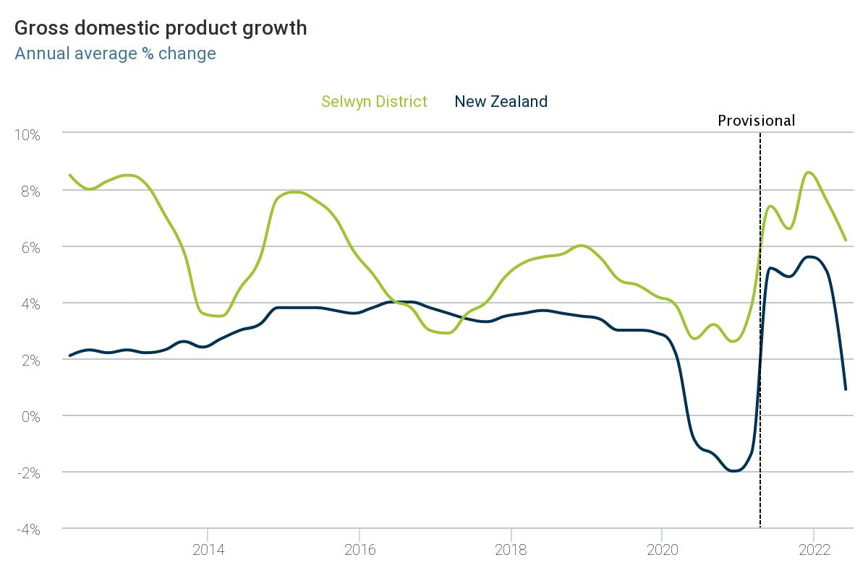
A bumpier start to 2022

Slide 5
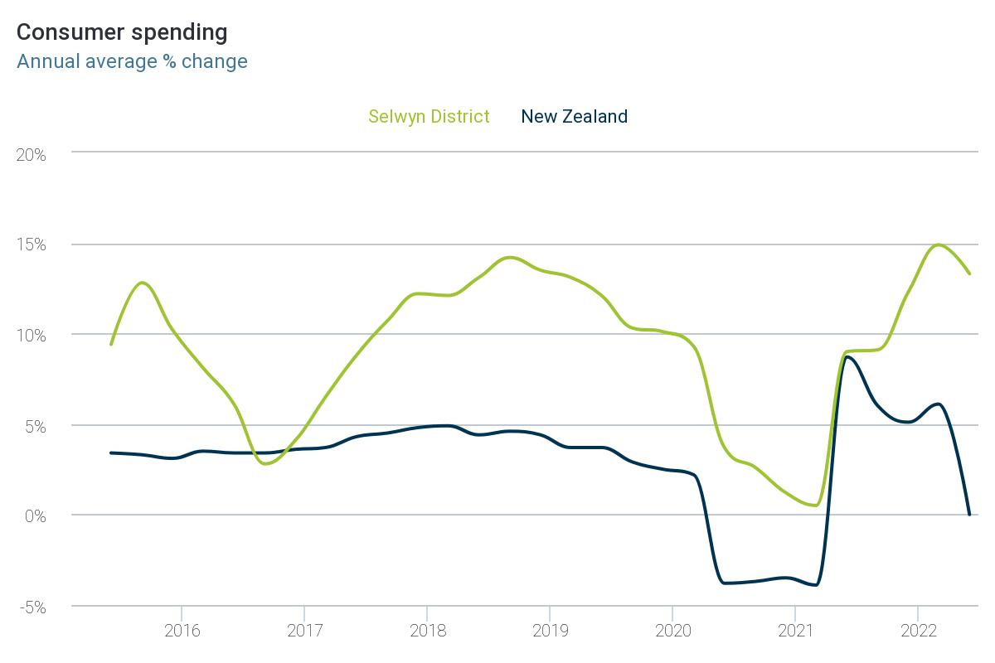
Households nationally have tightened belts

Slide 6
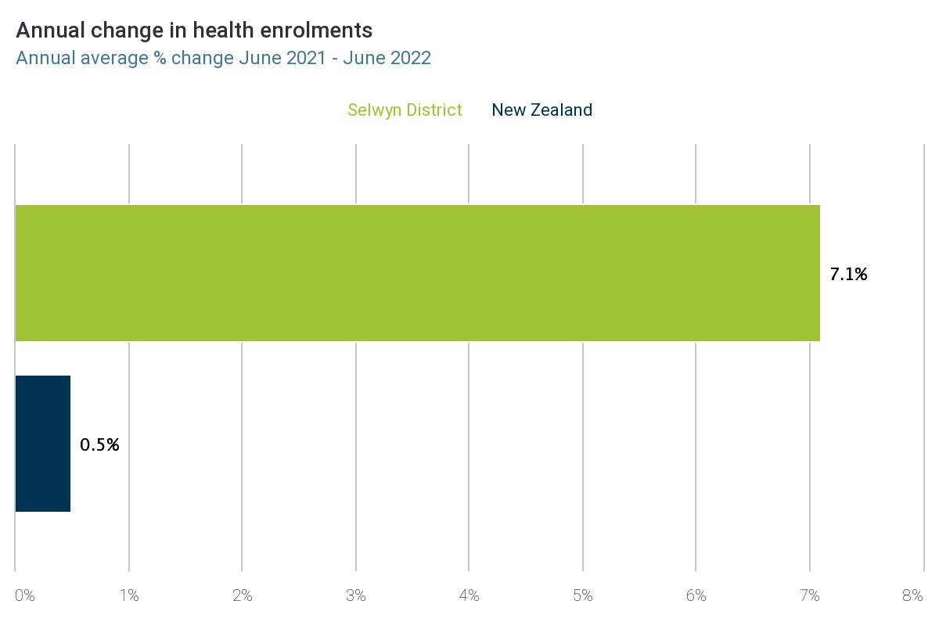
But population growth in Selwyn has remained strong

Slide 7
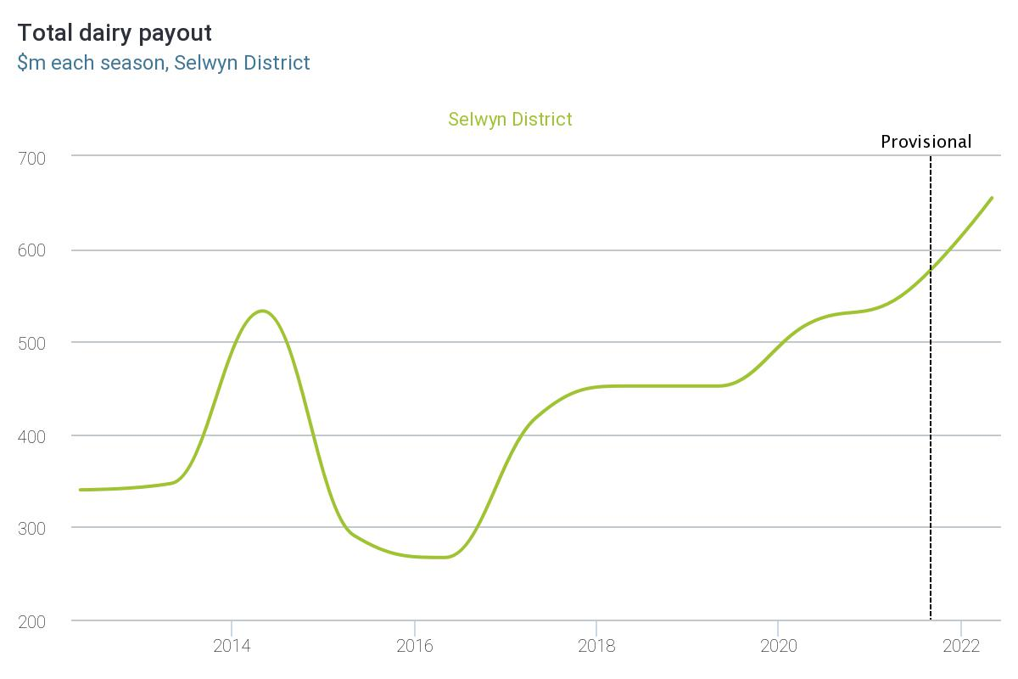
A record dairy payout has also helped

Slide 8
How are businesses now describing their experiences and expectations of the future?

Slide 9
Border reopenings have helped some, but….
The outlook is muddied:
Inflation
Interest rates
Emigration
Shortages – supplies, staff
Geopolitical risks
Recession concerns (globally).
How are businesses now describing their experiences and expectations of the future?

Slide 10
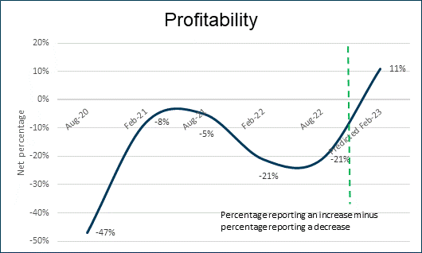
Profits expected to recover

Slide 11
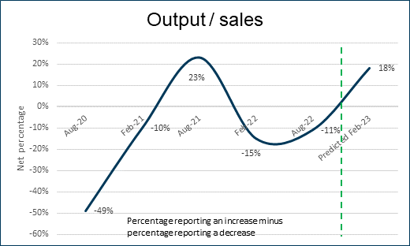
As sales perform better

Slide 12
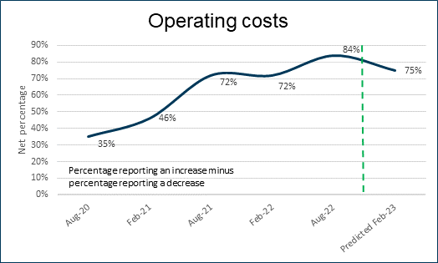
And businesses expect worst of cost increases to be behind them

Slide 13
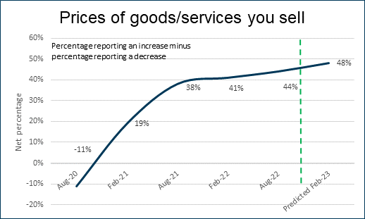
Businesses are also becoming more comfortable lifting their prices

Slide 14
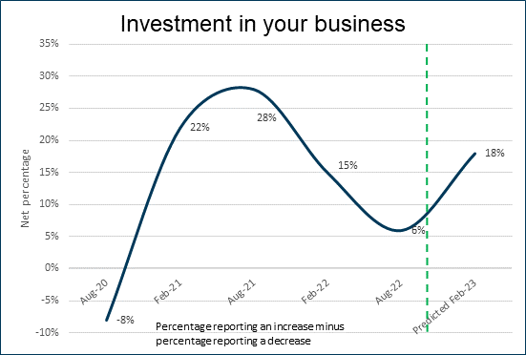
Confidence to invest is returning among local businesses

Slide 15
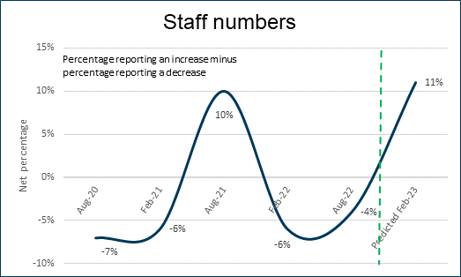
Unsurprisingly, businesses want to hire staff

Slide 16
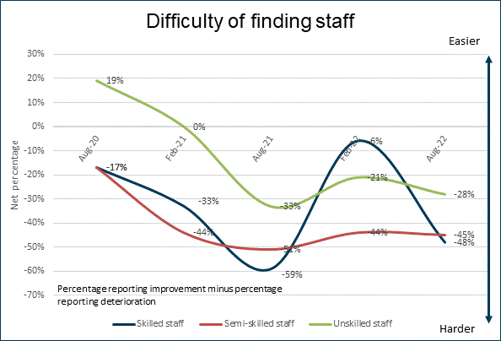
But finding staff has not become any easier since border reopenings

Slide 17
Summary
Despite a challenging past 6 months, Selwyn businesses have fared better than the national average.
Businesses are cautiously optimistic that the worm is turning for them – more so than businesses nationally.
But challenges persist. In particular:
Cost escalations are still a fact of life
Finding staff has gotten harder.

Slide 18
Time for Q & A → To what extent do you share these experiences of your peers?

Slide 19


CNZ’s Women in Work Initiative

Slide 20
Karen Haigh Talent Specialist, ChristchurchNZ

Slide 21

ChristchurchNZ
To stimulate sustainable economic growth for a prosperous Ōtautahi Christchurch

Slide 22
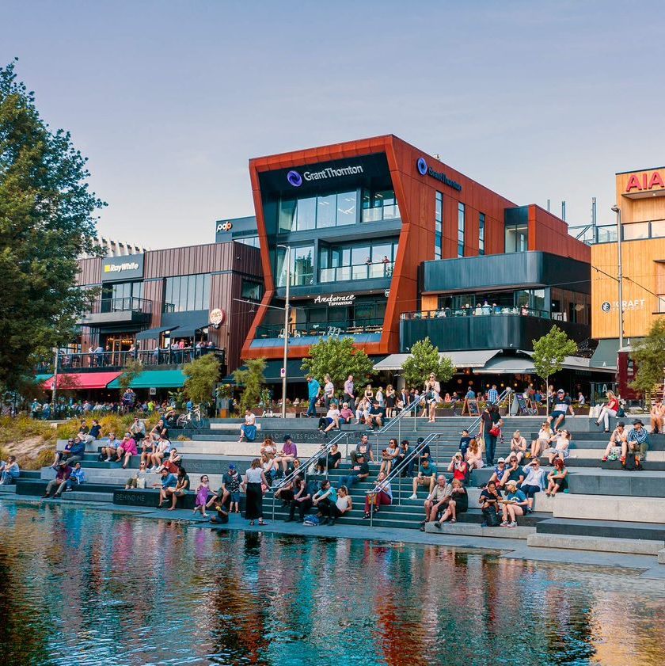





Priorities
High-value decent work
Productivity and GDP output
Resilience and sustainability of enterprise and businesses
Attractiveness of Christchurch to key audiences
Liveability

Slide 23


The No.1 challenge for our businesses right now is the skill shortage

Slide 24


18,900

Slide 25





























Notes:
Massive thanks to Denise Wiggins from Connected – who was integral in getting this group together and running the workshops – and has been super engaged with Ginny throughout the project – thanks Denise

Slide 26



Key project initiatives
Regionalised hub of information, events & support
Campaign to inspire, inform & connect
Employer capability building
01
02
03
Notes:
At this point we brought on Ginny Rhodes, many of you will know her from her other role as MD of DFS

Slide 27
Focus Groups
Women quickly lose confidence when taking a break from work
Women struggle to find quality/reputable information and advice that they need
Prefer small, interactive careers & information events
None of the women interviewed had any knowledge of regional growth sectors and potential opportunity, what regional job shortages there are now and in the future

Slide 28
Key project initiatives
Regionalised hub of information, events & support
Regionalised hub of information, events & support
Campaign to inspire, inform & connect
Employer capability building
01
02
03
01
Notes:
At this point we brought on Ginny Rhodes, many of you will know her from her other role as MD of DFS

Slide 29
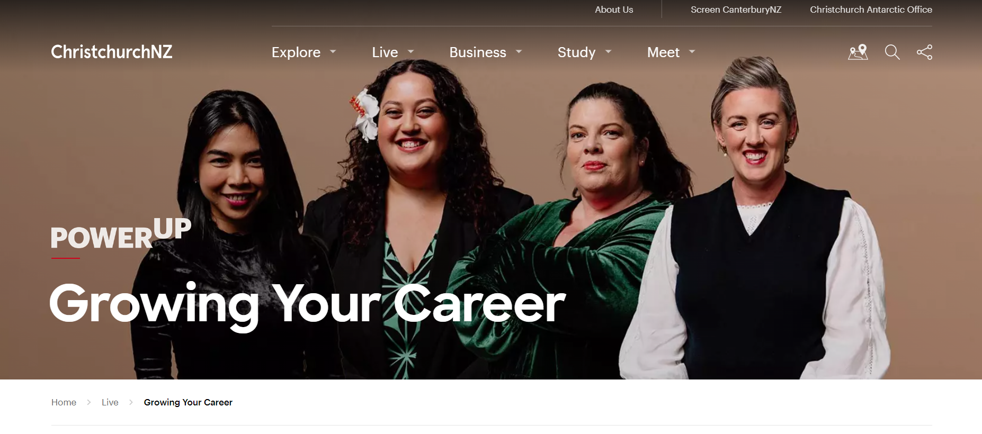

Notes:
INFORM
The content all comes together together in an online hub – featuring advice from Claire, stories from our four women, templates, handbooks, links to support and industry networking groups and events – all delivered in a way that reflects the needs of our women to see trustworthy, region-specific summarised information in one place and delivered in a way that reflects them as people.
One stop shop – doesn’t link off to other sites to provide information. We’ve taken the best information from careers sites and pulled it into one place.

Slide 30

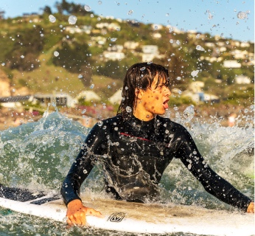
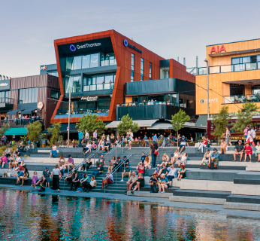




The Hub Content
Knowledge & Skills
Support & Connections
Vision
Job Search

Slide 31

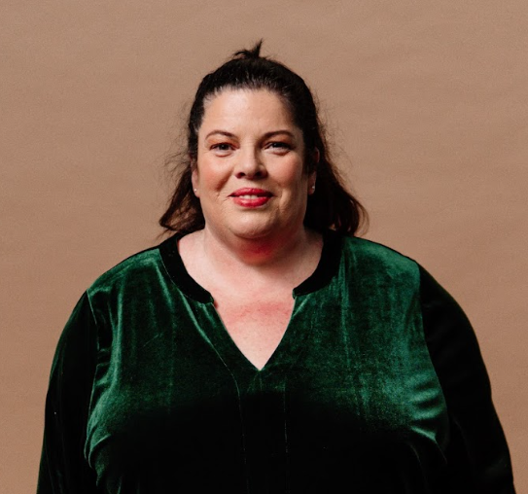
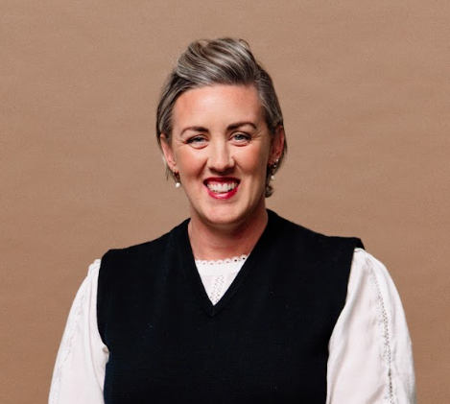
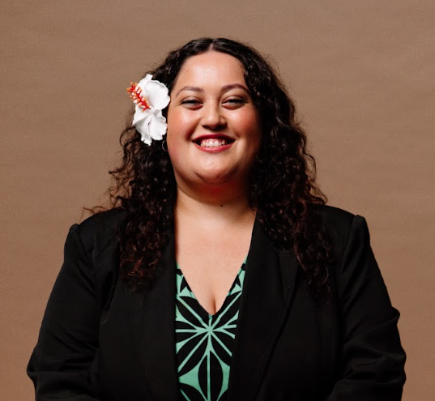
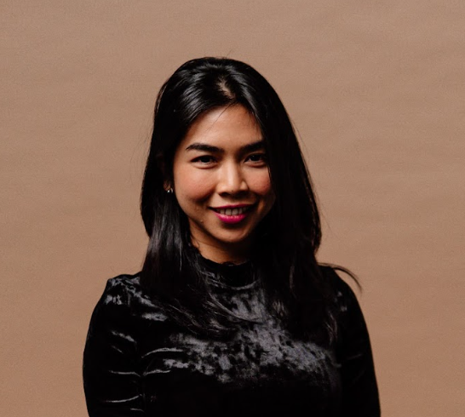
The Inspiration

Slide 32
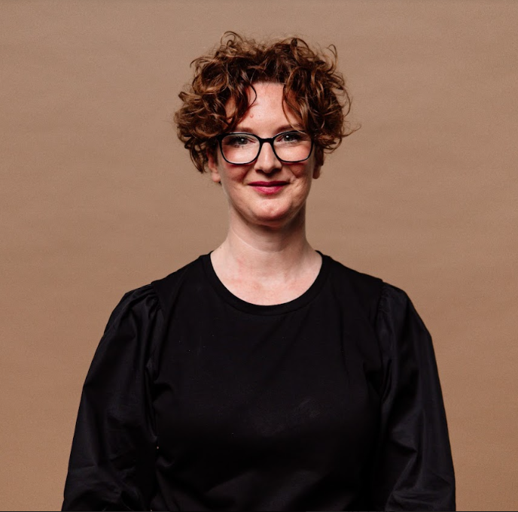
The Expert

Slide 33
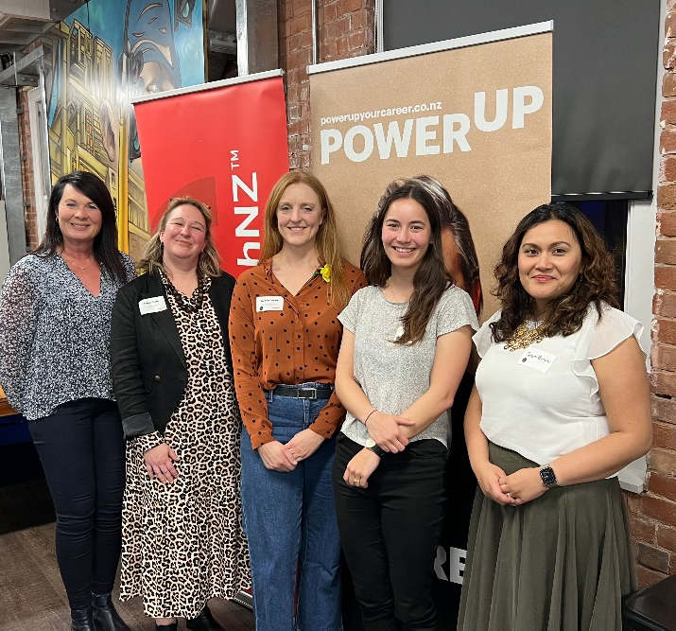
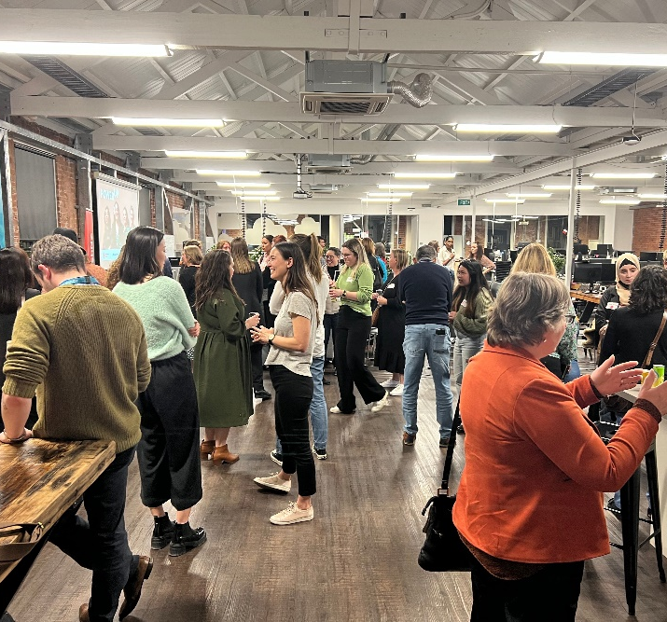
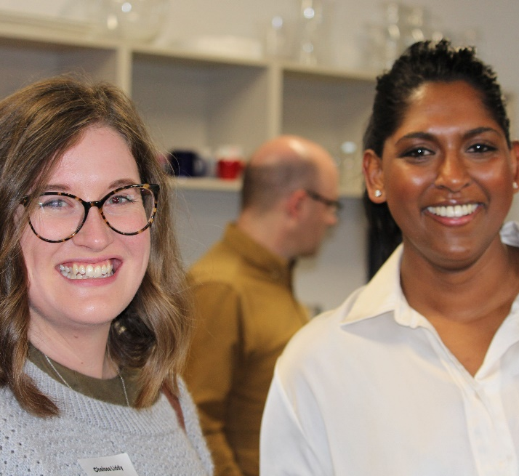
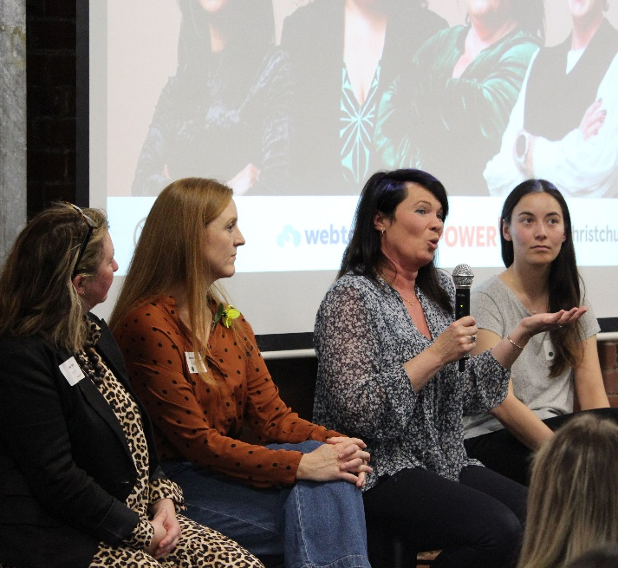
PowerUp a Career in Tech Event

Slide 34
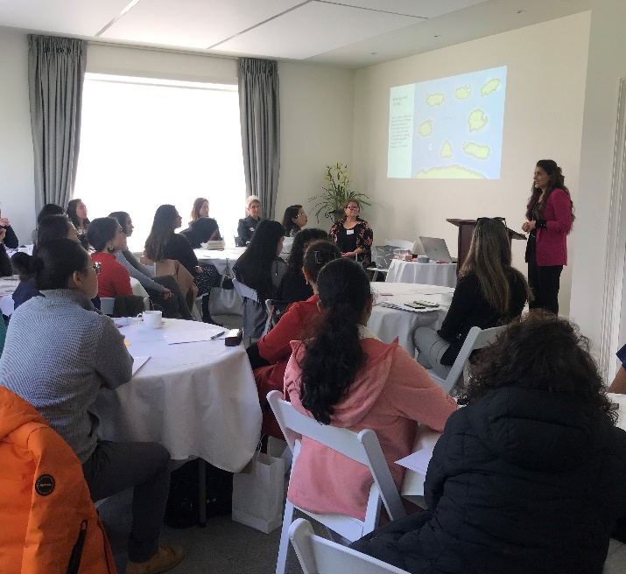
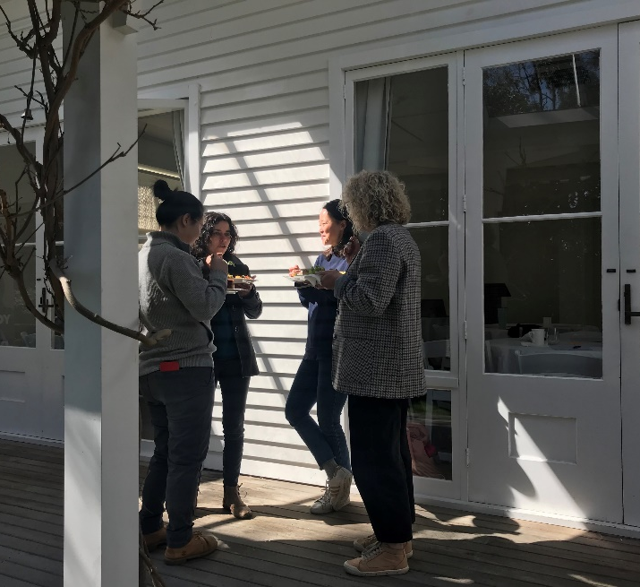
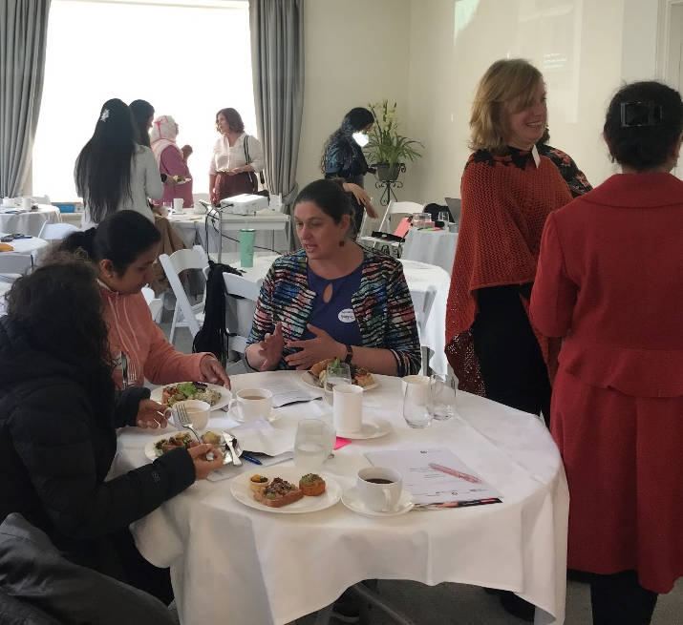
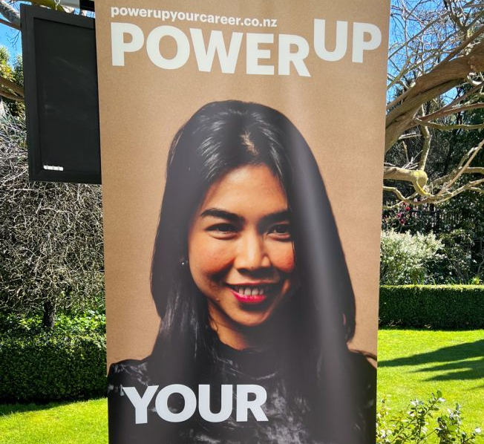
PowerUp your Professional Career Event

Slide 35
Key project initiatives
Campaign to inspire, inform & connect
Regionalised hub of information, events & support
Campaign to inspire, inform & connect
Employer capability building
01
02
03
02

Slide 36
The Objective
Raise awareness among the target audience of the hub as a place to access reliable, practical and Canterbury-specific information on the economy, labour market, career opportunities and support available.

Slide 37

The Audience
Returning to work
Retrain
Upskill
Jobseekers
Career changers
Youth
(18-24)

Slide 38


Slide 39



Notes:
INSPIRE

Slide 40



Slide 41


Slide 42


Slide 43
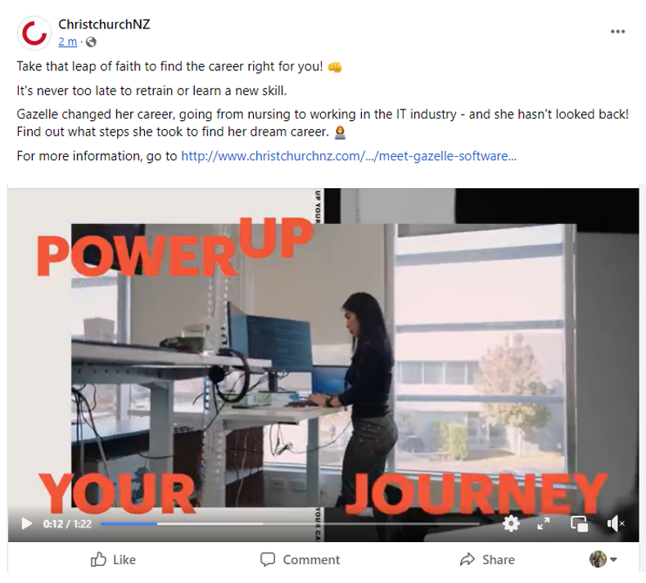
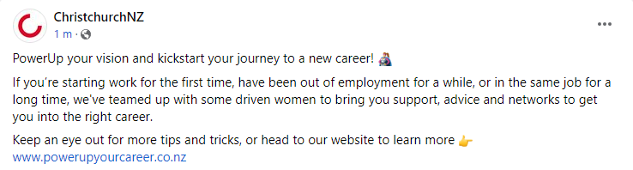
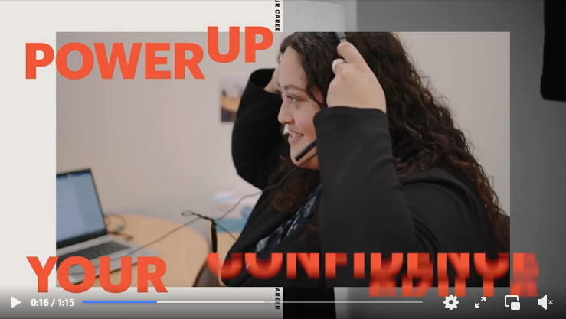
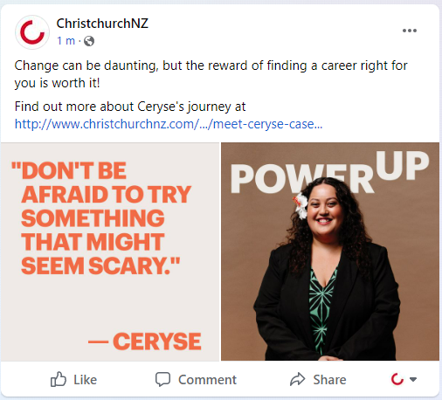

Slide 44
Key project initiatives
Employer capability building
Regionalised hub of information, events & support
Campaign to inspire, inform & connect
Employer capability building
01
02
03
03
Notes:
At this point we brought on Ginny Rhodes, many of you will know her from her other role as MD of DFS

Slide 45
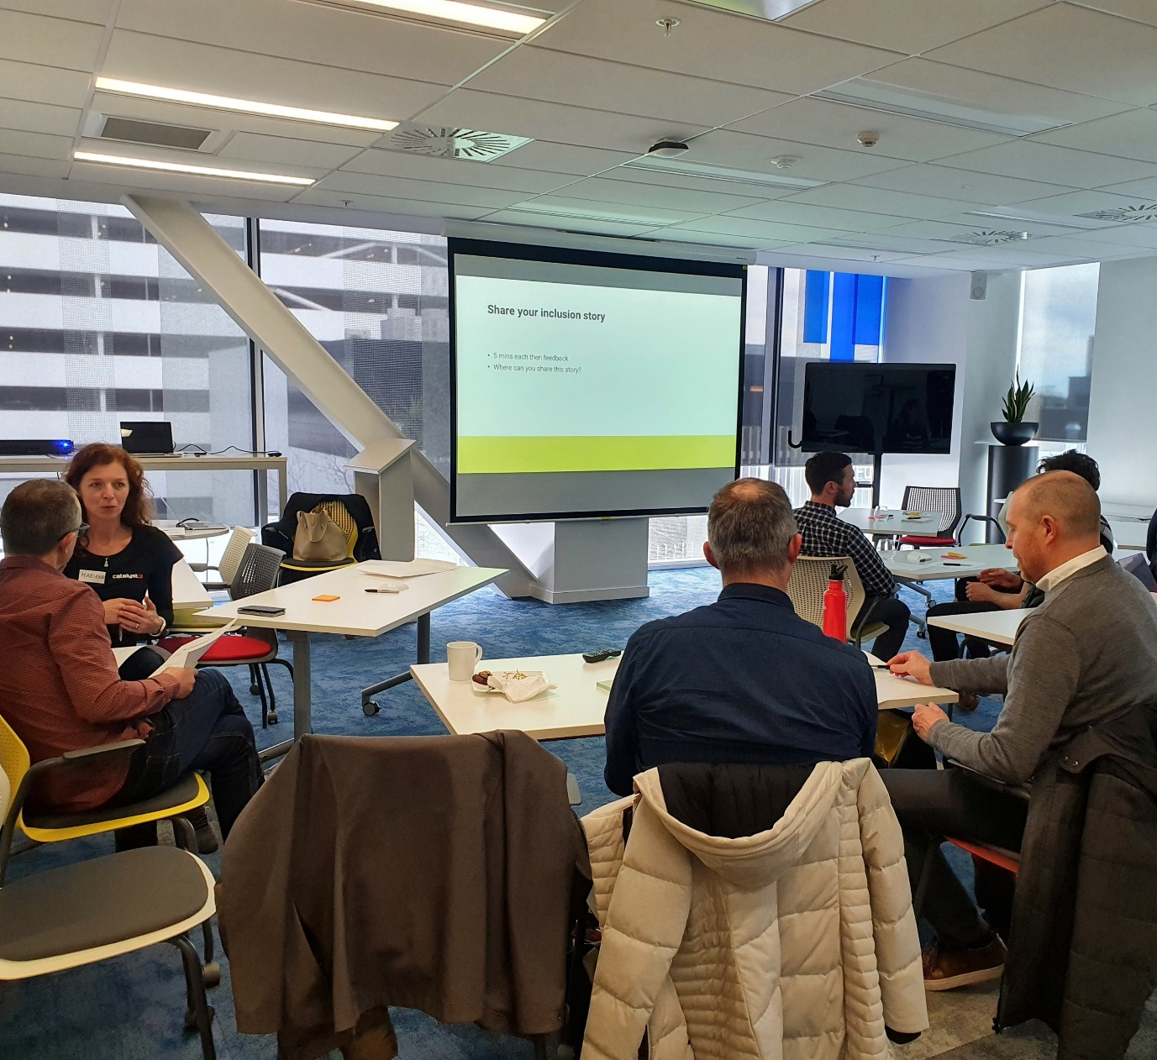
Diversity & Inclusion Workshop Pilot Series

Slide 46




How you can get involved
SHARE ChristchurchNZ’s content
POST the content on your own channels
ENGAGE with our posts
HOST an event and leverage the brand

Slide 47
Toolkit
Videos
Campaign images
Social copy
Logos
Email signature
Event marketing
Banners
Templates
Marketing
T-shirts

Slide 48
Coming Up
Continuation of Pilot D & I workshop series for tech businesses
Follow Up Careers in Tech event for women returners & career changers (October)
Follow up to Work-readiness conference for women from ethnic communities (November)
Supporting stakeholders to run events
Planning for next 8 months, and beyond…
Notes:
Brochures
Closing karakia

Slide 49
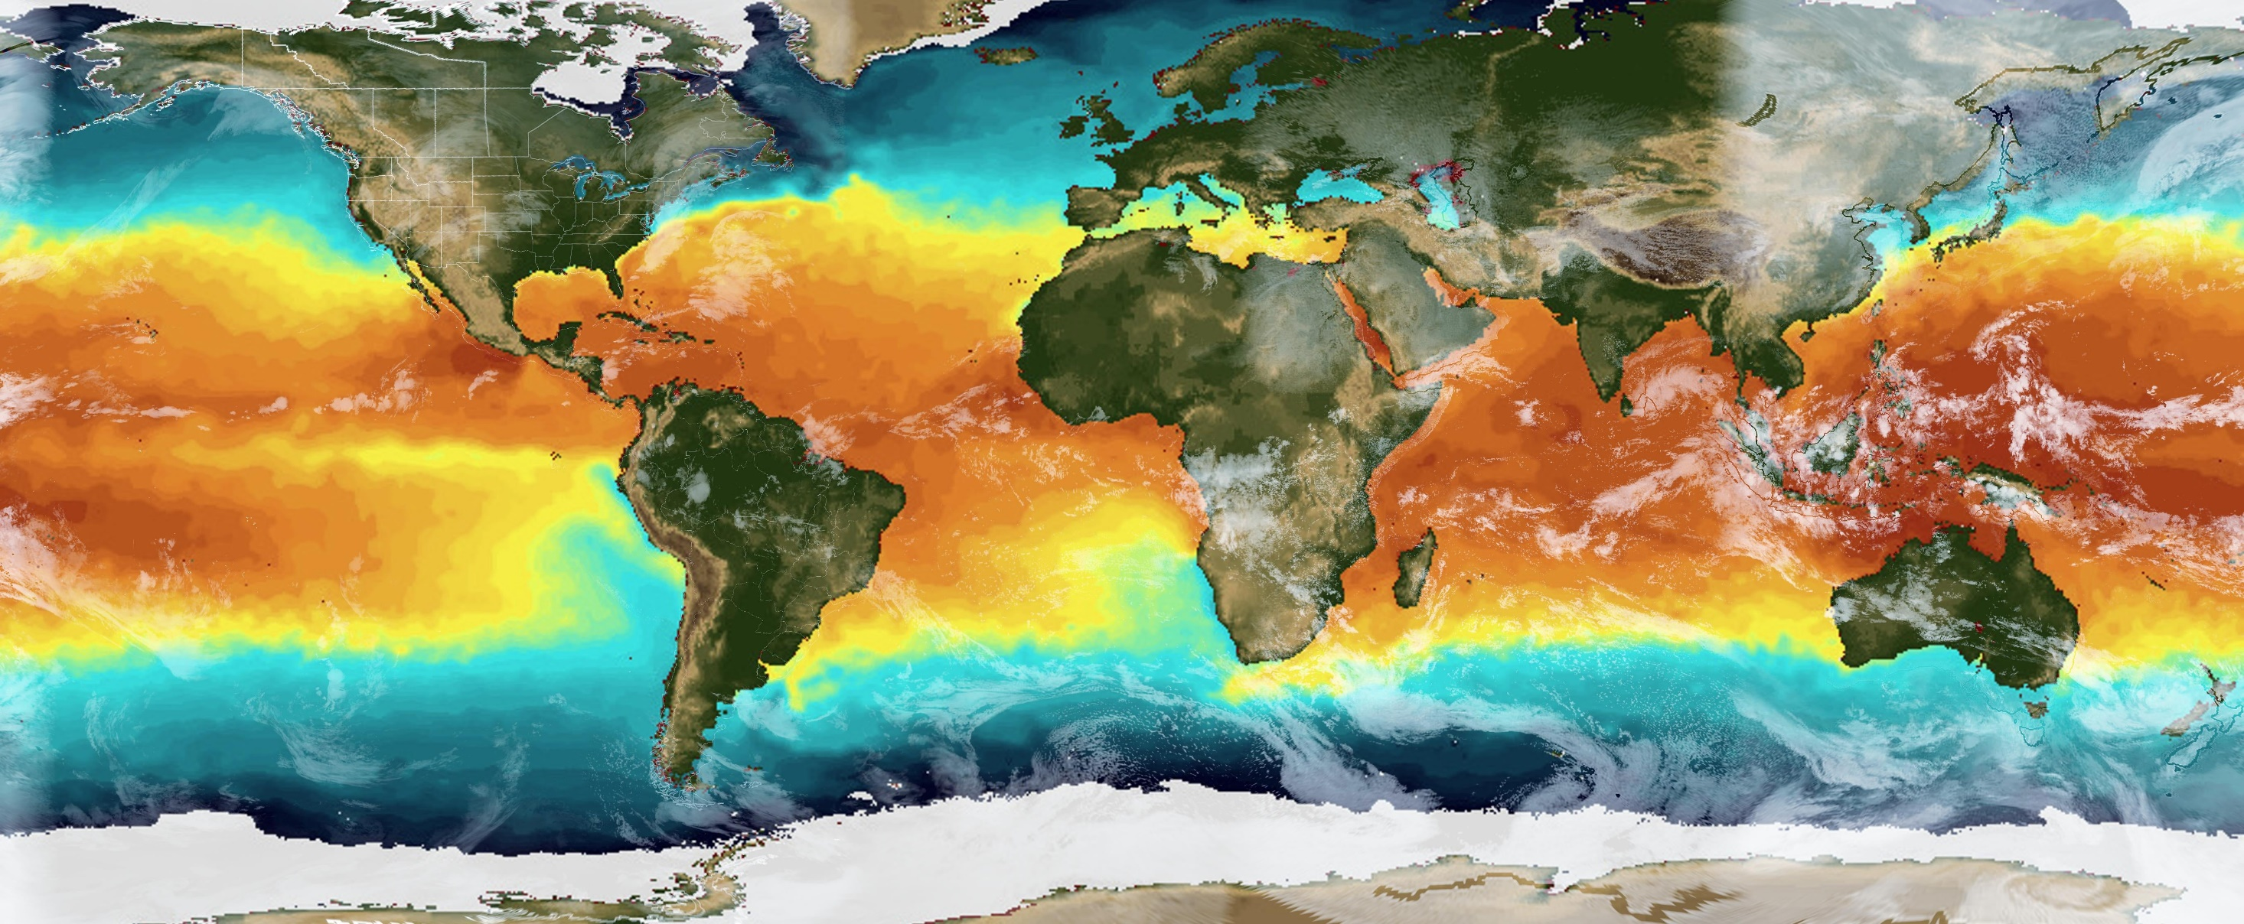


Selwyn Business Breakfast:
Understanding the impacts of climate change and what this means for business

Slide 50
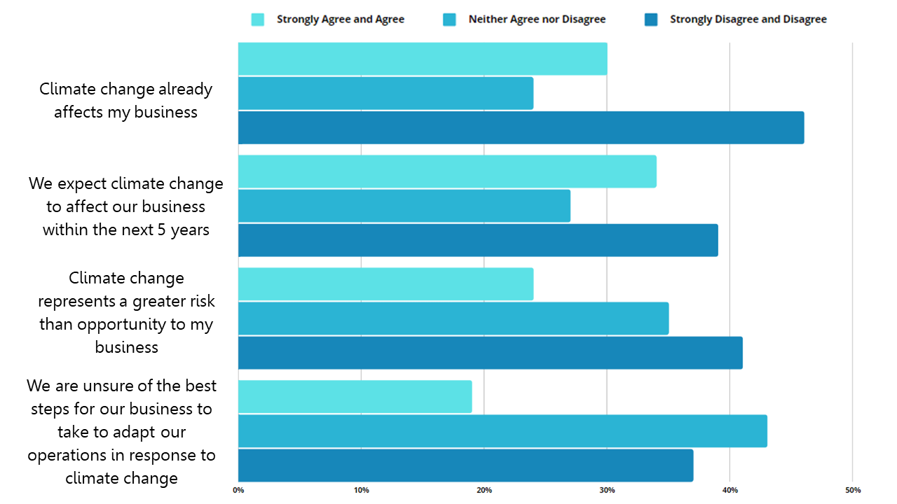
What do local businesses currently think?
Source: Selwyn Business Opinion
Survey 2022

Slide 51
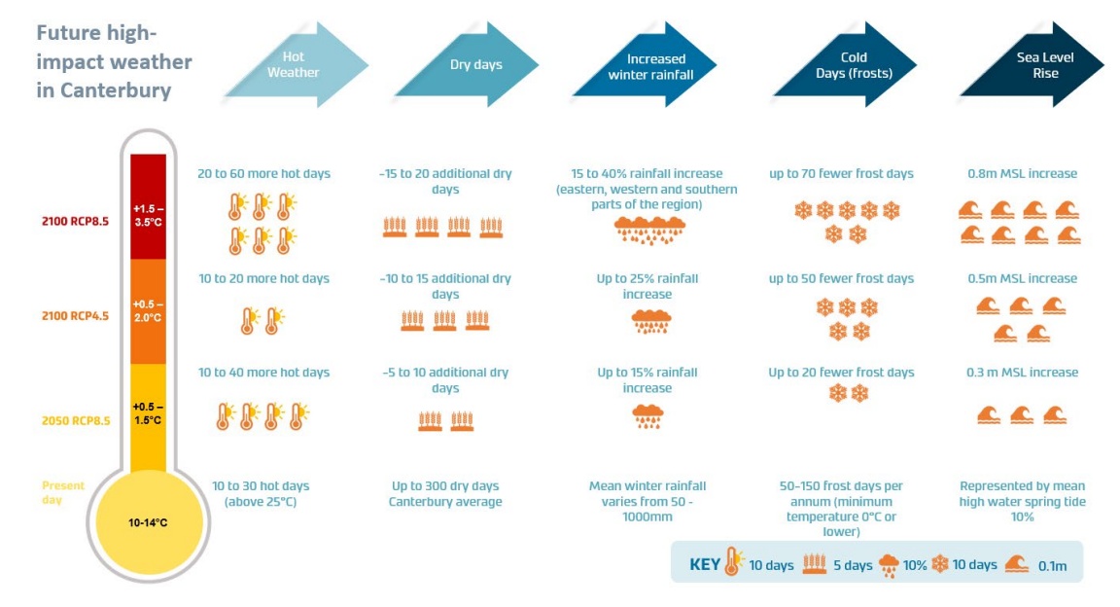
What are the anticipated impacts of climate change for Canterbury?
Source: Climate change projections
for the Canterbury Region,
February 2020

Slide 52
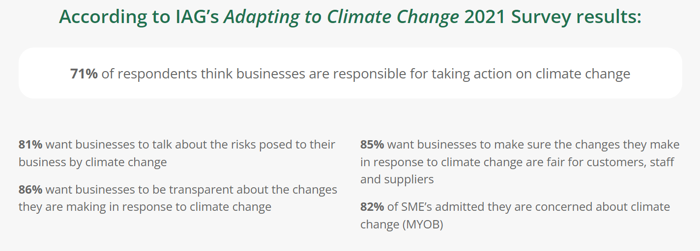
So why might I need to integrate climate issues as part of my business?
Meeting procurement expectations
Improved brand value and reputation
Meeting consumer demand and marketing advantage
Providing a platform for innovation
Business continuity and risk management
Increased resource efficiency
Staff retention and attraction
Strengthening stakeholder relations
Understanding emerging trends in your sector
Source: Sustainable Business
Network

Slide 53


Climate action is part of a wider shift to more sustainable business practices?
Source: UN Sustainable Development Goals

Slide 54


Where do I start and what help can I get?
Webinar Recap | BusinessNZ's webinar series All Things Carbon | Toitū Envirocare (toitu.co.nz)

Slide 55

And more is coming……

Slide 56

Upcoming events
Mayor’s Task Force for Jobs video and website Launch
Tuesday 25th October – Rolleston College
Current vacancies
Promoting your employment opportunities to year 13
Learn Earn Grown Selwyn (LEGS) series - March 2023
Job seekers living in Selwyn
Selwyn residents seeking training for employment opportunities
Selwyn-based businesses with vacancies looking to employ locally
Selwyn based SME and Start Ups wanting to grow business and customer reach
What do you want to see in this series?
Who would you like to hear from in relation to business growth and/or employment?
Preferred format? (e.g expo, small group sessions, workshops etc)
Preferred time of day and length of sessions?
Next Business event – Tuesday 13th December 2022
Notes:
Closing whakataukī
E koekoe te tūī, e ketekete te kākā, e kūkū te kererū
The tui chatters, the kākā cackles, the kererū coos
variously translated in English as ‘It takes all kinds of people’ or ‘By appreciating all our voices, our different songs, we make good music for the future’.

