Slide 1

Upper Selwyn Huts
Public meeting
Wednesday 28 February 2024

Slide 2
What we’re going to cover
Current situation
Wastewater update
Options for the new deed of licence
How to voice concerns or ask questions
How we can work together
UPPER SELWYN HUTS
PUBLIC MEETING 28 FEB 24

Slide 3
What are we here for?
To discuss a plan for the Upper Selwyn Huts
Notes:
We’re here to discuss what’s happening with the land and area Upper Selwyn Huts is and some of the things which will affect the huts in the future.

Slide 4
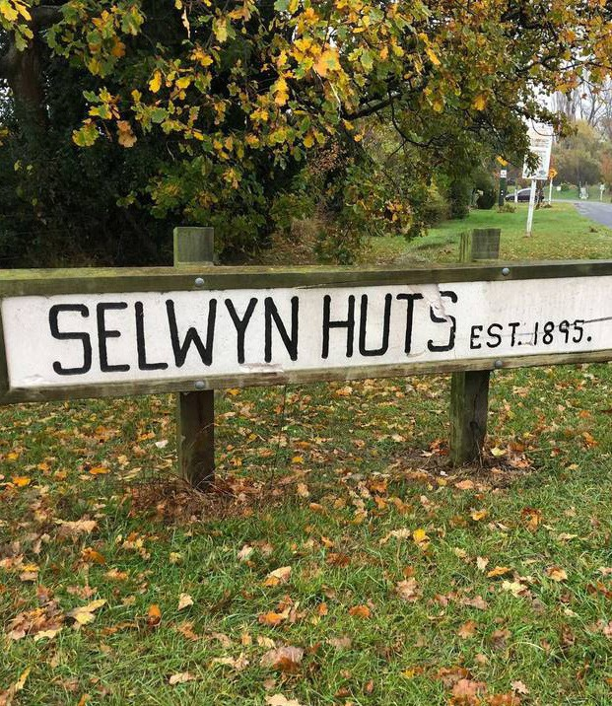
Where we're at
Wastewater upgrade needed
Changes to neighbouring hut communities
Increase in natural disasters meaning more evacuations
UPPER SELWYN HUTS
PUBLIC MEETING 28 FEB 24
Notes:
History of how we have got here – Sam to provide.
Ongoing challenges with supporting the community into the future
Overview of how a wastewater upgrade is needed
Wastewater is a problem for the other hut communities with DOC and Ngai Tahu no longer able to provide this to Greenpark and Lower Selwyn Huts.
More bad weather meaning more evacuations mostly due to the road flooding. And its not just being cut off - we need to evacuate to prevent resources going to the huts because someone stayed there instead of evacuating which diverts resources.
Additional information which may be needed here but can be discussed further in
USH community will pay for any Wastewater Solution – Council Resolution May 2019
Pines WWTP Pipeline and USH branch line cost now $35.56M.
The USH component estimated to be $4.06M revised.
Cost to USH owners originally briefed when pipe was approved was $1K per year for 15 yrs.
Cost revised to $4.48K per year for 15 yrs.

Slide 5
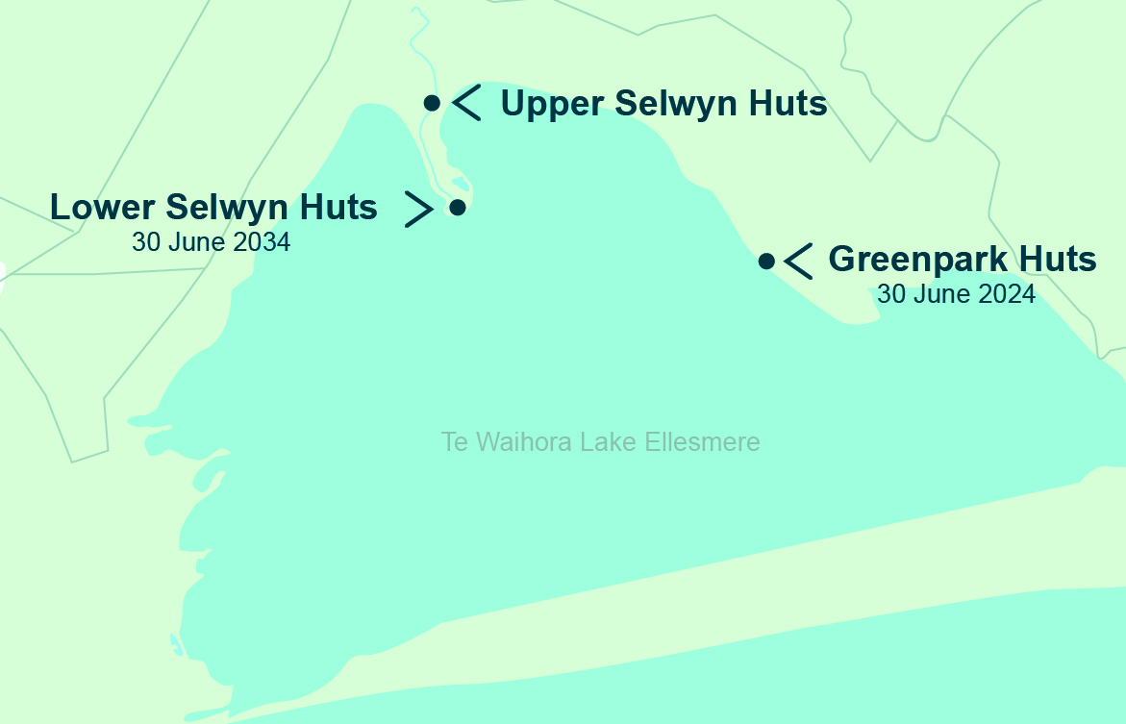
Neighbouring communities
UPPER SELWYN HUTS
PUBLIC MEETING 28 FEB 24
Notes:
DOC and Ngai Tahu are working towards the above dates and working with communities on details.
Lower Selwyn Huts date is
Part of the challenge is wastewater and the increasing bad weather.
This slide is about the neighbours not about USH

Slide 6
Wastewater and the pipeline
UPPER SELWYN HUTS
PUBLIC MEETING 28 FEB 24
Notes:
So Wastewater is a major concern.

Slide 7
Wastewater Pipeline
Environment Canterbury resource consent expired
New pipeline had been planned:
      Resource Consent for the work is delayed
      Delays in getting started
      Cost has increased due to inflation
Need to look at other options
Notes:
Resource Consent expired and ECAN agreed to extend this so long as a new pipeline was built.
A pipeline had been planned that was costed for the community in Upper Selwyn Huts to fund.
The project is caught up in the resource consent process, and this has delayed the start.
Options for exploring what we do instead. Such as truck waste out of the area. Range of options on the table. If we have to truck out if gives us time – find out if we want or can get consent
This takes pressure off the timeframe and gives us the chance to pause and consider what we need to do and within what timeframe. It gives us a chance to discuss next steps.
EXTRA CONTENT
Waste water to be paid for by the Upper Selwyn Huts community – this decisions was made by Councillors at a council meeting in May 2019.
It is part of a larger project of which the full cost is
Pines WW TP Pipeline and USH branch line will go ahead at cost of $35.56M.
The USH component estimated to be $4.06M which is a revised number
FURTHER DISCUSSION ON COST on NEXT SLIDE

Slide 8
Wastewater Pipeline Funding
Wastewater branch line to be paid for by the Upper Selwyn Huts community
        (Selwyn District Councillors decision, May 2019)
Notes:
Was originally 100% (Decision May 2019) now 50% recommendation 2024
Range of options on the table. If we have to truck out if gives us time – find out if we want or can get consent. But if we can’t get consent this is the proposal for right now.
Pines WWTP Pipeline and USH branch line will go ahead at cost of $35.56M.
The USH component estimated to be $4.o6M revised.
Cost to USH owners originally briefed when pipe was approved was $1K per year for 15 yrs.
Cost revised to $4.48K per year for 15 yrs.

Slide 9
Wastewater Pipeline Funding
Estimate sample costs for a hut valued at $50,000 paying 50%
of the pipeline costs
Years | Licence | Rates | 50% Pipeline | Total
5 | $ 1389 | $1,538 | $5,071 | $7,998
10 | $1,389 | $1,538 | $2,931 | $5,859
15 | $1,389 | $1,538 | $2,241 | $5,169
20 | $1,389 | $1,538 | $1,911 | $4,841
30 | $1,389 | $1,538 | $1,403 | $4,752
Notes:
Was originally 100% (Decision May 2019) now 50% recommendation 2024
Range of options on the table. If we have to truck out if gives us time – find out if we want or can get consent. But if we can’t get consent this is the proposal for right now.
This is not index linked so there will be increases in line with standard increases

Slide 10
Deed of licence
UPPER SELWYN HUTS
PUBLIC MEETING 28 FEB 24
Notes:
All of that means we have to talk about the deed of licence and what that means for the future.

Slide 11
Deed of Licence Length
We know we have to set a finite date on the next Deed of Licence
Selwyn District Councillors decision, 8 May 2019
The Council unanimously determined that ‘Hut licences and subsequent renewals are short term and ultimately for a finite period’
Current situation is year by year
Recommending 15 Years
Notes:
We know we now have to make a decision about what the final time period is for the Deed of Licence is for Upper Selwyn Huts
This was decided in a council decision on May 2019 at a public meeting.
Licences were sent out to extend the licences to the 30th June this year w3hich is the expiry.
Licences expire in 30 June 2024
Staff recommendation to Councillors is 15 years and Councillors will decide on that.
Giving you a new licence which will give you 15 years
5 + 5 + 5
We have options of between 5 and 30 years.
We are recommending 15 years.
Renewable at 5-year intervals
15 years after Green Park Huts
5 years after Lower Selwyn Huts
Ultimately Councillors are the final decision maker

Slide 12
Deed of LicenceTransfer
To support the change to the Deed of Licence length we need to set a date to stop transfers
Options for:
Set date
Phased transfer
Notes:
Part of deciding what we do with the DOL is to discuss what transfers look like.
Transfer of a DOL – Option
No transfer from Jun 2024 Phased transfer option
Transfers permitted until 30 Jun 2034
Recommended
Up to 30 Jun 2034, to anyone.
After 30 Jun 2034, only to identified persons

Slide 13
Deed of Licence Regulations
Part of our job is to keep you safe
Our monitoring needs to be better
Council funded inspection programme
Work together to fix any issues as part of the conditions of licence
Notes:
We’re looking at what other conditions needs to support the need to set a finite period and work towards that.
Interim solution of the wastewater gives breathing space to allow council and community to work through what that could be. Which would involved better compliance monitoring to keep you and your neighbours safe.
Safety of building act
No environmental safety issues like fire risk
Repairs or any remediation will be funded by the hut owner.

Slide 14
Deed of Licence Process Key Dates
TODAY
28 Feb
COUNCIL MEETING
13 Mar
LICENCE AVAILABLE
29 Mar
FINAL LICENCE SIGN OFF
27 May
LICENCE EFFECTIVE
30 Jun
F E B
M A R
A P R
M A Y
J U N
Notes:
There is a process we have been working to with a timeframe.
Reiterate the wastewater option isn’t them being left out.
We need to discuss what this means.
29th April is when you can sign your licence which needs to be done and it will then be effective on 30th June.

Slide 15
Concerns and questions
UPPER SELWYN HUTS
PUBLIC MEETING 28 FEB 24
Notes:
We have our standard customer service lines to do this – so either call us and your query will be captured and responded to or use our online form. 0800 SELWYN (735 996)
Tim is in charge of this work
Sharon happy to meet
If a group setting isn’t comfortable for you then we can arrange another way of speaking to you.

Slide 16
How to get in Touch
0800 SELWYN (735 996)
huts@selwyn.govt.nz
Tim Harris – Point of contact
Notes:
We know we now have to make a decision about what the final time period is for the Deed of Licence is for Upper Selwyn Huts
This was decided in a council decision on May 2019 at a public meeting.
We have options of between 5 and 30 years.
7
We are recommending 15 years.
Renewable at 5-year intervals
15 years after Green Park Huts
5 years after Lower Selwyn Huts
Ultimately Council is the final decision maker

Slide 17
How do we work together?
UPPER SELWYN HUTS
PUBLIC MEETING 28 FEB 24
Notes:
Let’s discuss what working together looks like.
Do we form a project group?
What could that look like?
Support team of government agencies to explore what the future is for this community.

Slide 18
Questions?
UPPER SELWYN HUTS
PUBLIC MEETING 28 FEB 24
Notes:
Reiterate how to get in touch if you have further questions

Slide 19
What Next?
UPPER SELWYN HUTS
PUBLIC MEETING 28 FEB 24
Notes:
Next steps – Reiterate timeline next slide

Slide 20
Deed of Licence Process Key Dates
TODAY
28 Feb
COUNCIL MEETING
13 Mar
LICENCE AVAILABLE
29 Mar
FINAL LICENCE SIGN OFF
27 May
LICENCE EFFECTIVE
30 Jun
F E B
M A R
A P R
M A Y
J U N
Notes:
There is a process we have been working to with a timeframe.
Reiterate the wastewater option isn’t them being left out.
We need to discuss what this means.
29th March is when you can sign your licence which needs to be done and it will then be effective on 30th June.

